Slide 1
23ITC01 Internet of things
Class: III CSE
Academic Year: 2025-2026 (ODD Sem)
Module 1: INTRODUCTION TO INTERNET OF THINGS AND IOT DESIGN METHODOLOGIES

Slide 2
23ITC01 Internet of things –Course Outcomes
CO1 | Understand the core principles and architecture of IoT systems to enable the development of IoT-based solutions. | [U]
CO2 | Interpret design constraints and challenges in developing IoT systems. | [AN]
CO3 | Develop cost-effective IoT solutions and interface with embedded platforms like Arduino, Raspberry Pi, or similar boards. | [AP]
CO4 | Analyze cloud platforms for deploying, managing, and ensuring the security of IoT solutions. | [AN]
CO5 | Apply data analytics to IoT data using Hadoop and MapReduce, demonstrating effective IoT design and implementation. | [AP]

Slide 3
Syllabus
Module 1: INTRODUCTION TO INTERNET OF THINGS AND IOT DESIGN METHODOLOGIES 15 hrs
Characteristics of IoT, Physical Design of IoT, IoT Protocols, IoT Reference Architecture, Logical Design of IoT, IoT Levels & Deployment Templates, Domain Specific IoT, IoT Vs M2M Vs IoE, IoT Design Methodologies.
Module 2: SYSTEM HARDWARE FOR IOT 5 hrs
Sensors and Actuators – Hardware Kits: Arduino, Node MCU, Raspberry Pi. Arduino UNO: Physical Design – Interfaces – Arduino IDE – Arduino Programming with examples: Digital IO – Analog IO – Serial Communication – Condition and Looping statements. Raspberry Pi: Physical Design – Interfaces – Pi programming using Python with examples – Python Packages for IoT.
Module 3: CLOUD AND DATA ANALYTICS FOR IOT 10 hrs
Cloud: Types of Cloud - loT with Cloud challenges - Selection of cloud for loT applications - Fog and Edge computing for loT - Cloud security aspects for loT applications. Data Analytics for IoT: Overview of Hadoop ecosystem – MapReduce architecture – MapReduce Job Execution – MapReduce Schedulers. Case study: Internet of Medical Things (IoMT)

Slide 4

Books to refer
Text Books:
Arshdeep Bahga and Vijay Madisetti, “Internet of Things: A Hands-on Approach”, 1st Edition, Universities Press, 2015.
Hanes David, Salgueiro Gonzalo, Grossetete Patrick, Barton Rob, Henry Jerome, “IoT Fundamentals: Networking Technologies, Protocols and Use Cases for the Internet of Things”, 1st Edition, Pearson Education, 2017
Mark Torvalds, “Arduino Programming: Step-by-step guide to mastering Arduino hardware and software”, 2nd Edition, 2018.
Reference Books:
Srinivasa K. G.,Siddesh G. M., Hanumantha Raju R., “Internet of Things”, 1st Edition, Cengage Learning India Pvt. Ltd., 2018.
Raj Kamal, “Internet of Things”, 1st Edition, McGraw Hill Education, 2017.
Dr. Simon Monk, “Programming the Raspberry Pi: Getting Started with Python”, 2nd Edition, McGraw-Hill Education, 2016.
Blum, “Arduino Programming”, 1st Edition, Pearson Education, 2020.

Slide 5
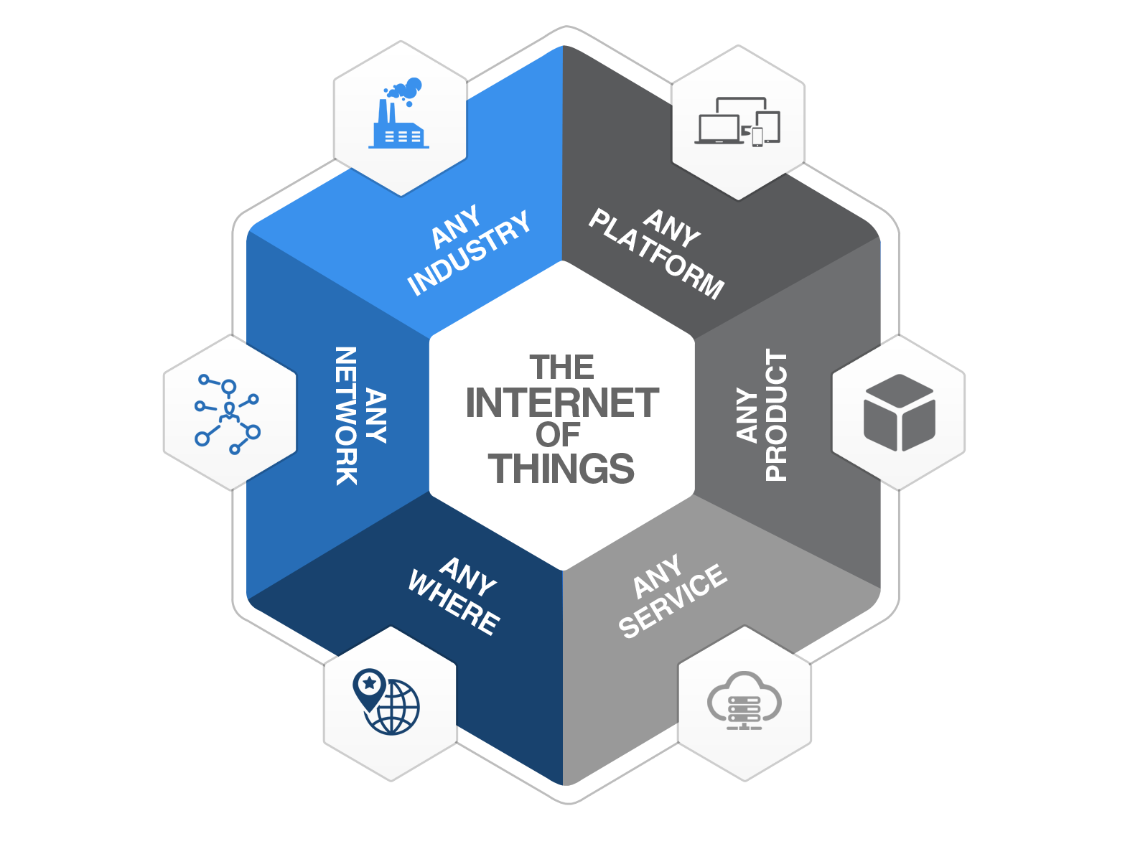

Module 2
SYSTEM HARDWARE FOR IOT: 5 hrs
Sensors and Actuators – Hardware Kits: Arduino, Node MCU, Raspberry Pi. Arduino UNO: Physical Design – Interfaces – Arduino IDE – Arduino Programming with examples: Digital IO – Analog IO – Serial Communication – Condition and Looping statements. Raspberry Pi: Physical Design – Interfaces – Pi programming using Python with examples – Python Packages for IoT
Watch this video: Click Here
Module 2

Slide 6
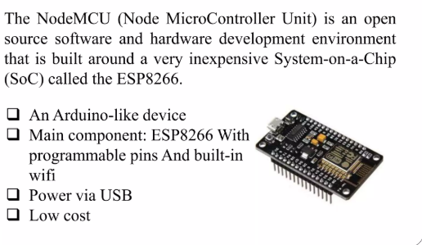
2.3 Node MCU

Slide 7
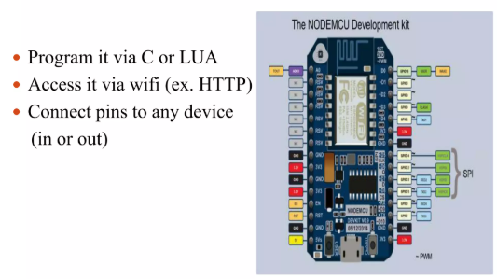
2.3 Node MCU

Slide 8
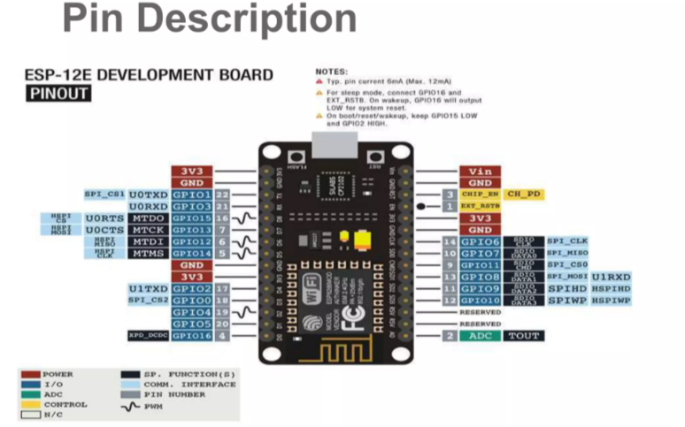

Slide 9
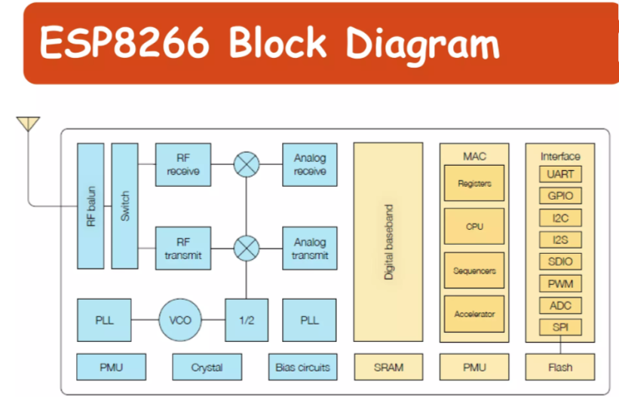

Slide 10
2.3 Features of NODE MCU
Microcontroller: ESP8266EX
Processor: 32-bit Tensilica L106 RISC processor
Clock Speed: 80 MHz (can be overclocked to 160 MHz)
Flash Memory: 4MB (default), expandable up to 16MB
RAM: 64KB instruction RAM + 96KB data RAM
Wi-Fi: 802.11 b/g/n (2.4 GHz) with WPA/WPA2 security
SPI, UART, I2C Support: Communication with external devices
ADC (Analog-to-Digital Converter): 10-bit ADC (0-1V range)

Slide 11
The ESP8266 uses a 32bit microcontroller with 16 bit instructions.
It is Harvard architecture which mostly means that instruction memory and data memory are completely separate.
The ESP8266 has on die program Read-Only Memory (ROM) which includes some library code and a first stage boot loader.
All the rest of the code must be stored in external Serial flash memory (provides only serial access to the data - rather than addressing individual bytes, the user reads or writes large contiguous groups of bytes in the address space serially).
Depending on your ESP8266, the amount of available flash memory can vary.

Slide 12
As any other microcontroller, ESP8266 has a set of GPIO pins (General Purpose Input(Output pins) that we can use to “control” external sensors.
Our ESP8266 has 17 GPIO pins but only 11 can be used (among 17 pins, 6 are used for communication with the on-board flash memory chip). It also has an analog input (to convert a voltage level into a digital value that can be stored and processed in the ESP8266).
It also has a WIFI communication to connect your ESP8266 to your WIFI network, connect to the internet, host a web server, let your smartphone connect to it, etc.

Slide 13
Power Pins:
There are four power pins. VIN pin and three 3.3V pins.VIN can be used to directly supply the NodeMCU/ESP8266 and its peripherals.
Power delivered on VIN is regulated through the onboard regulator on the NodeMCU module – you can also supply 5V regulated to the VIN pin
3.3V pins are the output of the onboard voltage regulator and can be used to supply power to external components.
GND are the ground pins of NodeMCU/ESP8266

Slide 14
I2C Pins
I2C Pins are used to connect I2C sensors and peripherals.
Both I2C Master and I2C Slave are supported.
I2C interface functionality can be realized programmatically, and the clock frequency is 100 kHz at a maximum.
It should be noted that I2C clock frequency should be higher than the slowest clock frequency of the slave device.

Slide 15
GPIO Pins
NodeMCU/ESP8266 has 17 GPIO pins which can be assigned to functions such as I2C, I2S, UART, PWM, IR Remote Control, LED Light and Button programmatically.
Each digital enabled GPIO can be configured to internal pull-up or pull-down, or set to high impedance.
When configured as an input, it can also be set to edge-trigger or level-trigger to generate CPU interrupts.

Slide 16
ADC Channel
The NodeMCU is embedded with a 10-bit precision SAR ADC. The two functions can be implemented using ADC.
Testing power supply voltage of VDD3P3 pin and testing input voltage of TOUT pin. However, they cannot be implemented at the same time.

Slide 17
UART Pins
NodeMCU/ESP8266 has 2 UART interfaces (UART0 and UART1) which provide asynchronous communication (RS232 and RS485), and can communicate at up to 4.5 Mbps.
UART0 (TXD0, RXD0, RST0 & CTS0 pins) can be used for communication. However, UART1 (TXD1 pin) features only data transmit signal so, it is usually used for printing log.

Slide 18
SPI Pins
NodeMCU/ESP8266 features two SPIs (SPI and HSPI) in slave and master modes. These SPIs also support the following general-purpose SPI features:
4 timing modes of the SPI format transfer
Up to 80 MHz and the divided clocks of 80 MHz
Up to 64-Byte FIFO

Slide 19
SDIO Pins
NodeMCU/ESP8266 features Secure Digital Input/Output Interface (SDIO) which is used to directly interface SD cards. 4-bit 25 MHz SDIO v1.1 and 4-bit 50 MHz SDIO v2.0 are supported.

Slide 20
PWM Pins The board has 4 channels of Pulse Width Modulation (PWM). The PWM output can be implemented programmatically and used for driving digital motors and LEDs. PWM frequency range is adjustable from 1000 μs to 10000 μs (100 Hz and 1 kHz).
Control Pins are used to control the NodeMCU/ESP8266. These pins include Chip Enable pin (EN), Reset pin (RST) and WAKE pin.
EN: The ESP8266 chip is enabled when EN pin is pulled HIGH. When pulled LOW the chip works at minimum power.
RST: RST pin is used to reset the ESP8266 chip.
WAKE: Wake pin is used to wake the chip from deep-sleep.

Slide 21
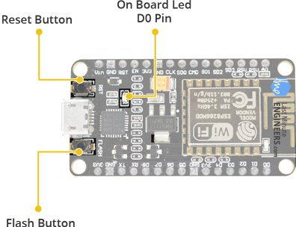
On-board Switches & LED Indicator
RST – Reset the ESP8266 chip
FLASH – Download new programs
Blue LED – User Programmable

Slide 22
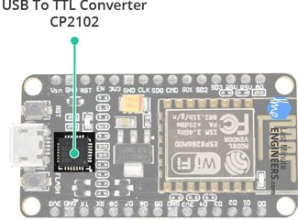
Serial Communication
CP2102 USB-to-UART converter
4.5 Mbps communication speed
Flow Control support

Slide 23
NODE MCU
Advantages
Low energy consumption
Integrated support for WIFI network
Reduced size of the board
Low Cost
Disadvantages
Need to learn a new language and IDE
Less pinout

Slide 24
Smart Irrigation System using ESP32
The smart irrigation system using ESP32 automatically takes care of the optimization of the basic soil conditions.
It continuously checks for values from different sensors and sends commands to the other components to work accordingly.
The Internet of Things (IoT) is a highly demanding field that is applied in multiple domains of life such as agricultural.
It is the most dominant field that has been revolutionized by integrating sensors, machines, data analytics, etc.
It has the potential to increase efficiency and performance, improve resource management, enhance crop quality, and, as a result, empower farmers.

Slide 25
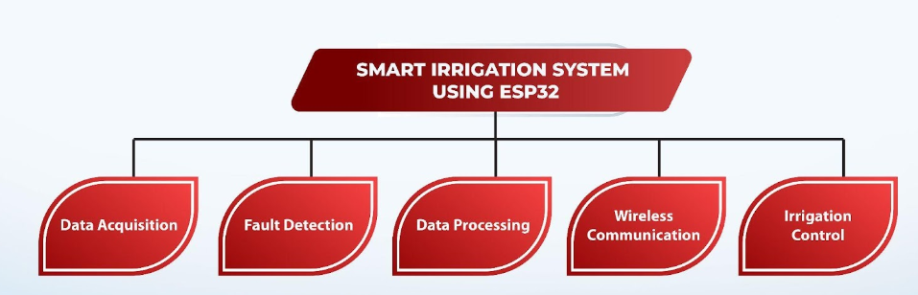
Block Diagram

Slide 26
Use a Smart Irrigation System
Smart Irrigation System Conserves Water
The sensors of this system continuously sense the values of soil moisture and deliver water only when required.
The water schedule does not remain the same all the time, but multiple factors affect the required amount of water for the plant, such as humidity in the air and temperature.
These factors are regularly monitored by the sensors

Slide 27
Smart Irrigation System Results in Better Yield
The frequency of watering is an important factor in the plant's health and yield.
With the help of this system, the optimal watering level leads to thriving plants with healthy growth.

Slide 28
Smart Irrigation System using ESP32 is a Time Saver
The most prominent advantage of this watering system is that it saves time.
The plants have a unique nourishment system that requires watering early in the morning or at the optimal time.
This is usually different from the human routine, and the automatic watering system is a stress-free solution in such situations.

Slide 29
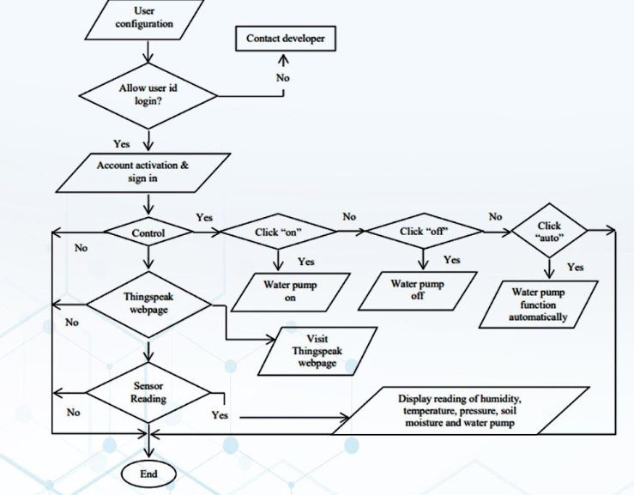
Flow Diagram of Smart Irrigation System using ESP32

Slide 30
Smart Irrigation System using ESP32
Two temperature sensors placed at different points on the soil, and these provide the values from two different parts of the soil.
The ESP32 is coded in the Arduino IDE, continuously checks the information from the sensors, and when the threshold values mentioned in the code are encountered,
Whenever the moisture of the plants is lower than the set values, the pump starts, and the steady flow of water starts on the soil.

Slide 31
Smart Irrigation System using ESP32
Similarly, the temperature sensed by the DHT11 is used to provide the necessary optimized conditions.
The water flow in the smart irrigation system using ESP32 is controlled with the help of relays
The relay controls the water pump or water valve in the smart irrigation system.
It takes the values from the moisture sensors and allows the water to flow from different systems connected to them.

Slide 32
Smart Irrigation System using ESP32
Reads the soil moisture level from the sensor using GPIO 34 (Analog Input).
Compares the moisture level with a predefined threshold (500).
If soil is dry (moisture < 500) → The relay turns ON, activating the water pump.
If soil is wet (moisture ≥ 500) → The relay turns OFF, stopping the water pump.
Updates the Serial Monitor every 5 seconds with the moisture level and pump status.

Slide 33
Smart Irrigation System using ESP32 -Program
#define SOIL_SENSOR_PIN 34
#define RELAY_PIN 26
#define MOISTURE_THRESHOLD 500
void setup()
{
Serial.begin(115200);
pinMode(RELAY_PIN, OUTPUT);
digitalWrite(RELAY_PIN, LOW);
}

Slide 34
Smart Irrigation System using ESP32 -Program
void loop()
{
int moisture = analogRead(SOIL_SENSOR_PIN);
Serial.print("Soil Moisture Level: ");
Serial.println(moisture);
if (moisture < MOISTURE_THRESHOLD)
{
Serial.println("Soil is dry. Turning ON Water Pump..."); digitalWrite(RELAY_PIN, HIGH);
}

Slide 35
Smart Irrigation System using ESP32 -Program
else
{
Serial.println("Soil has enough moisture. Turning OFF Water Pump...");
digitalWrite(RELAY_PIN, LOW);
}
delay(5000);
}

Slide 36
To write an Arduino sketch for connecting ESP8266 to WiFi Service
#include <ESP8266WiFi.h>
char ssid[]=“SSID”;
char pass[]=“pass”;
void setup()
{
Serial.begin(115200);
delay(1000);
Serial.print(“Trying to Connect…”);
Serial.println(ssid);
delay(1000);
WiFi.disconnect(); //Disconnect any other Wifi is connected
WiFi.begin(ssid, pass);
while(WiFi.status() != WL_CONNECTED)
{
delay(500);
Serial.print(“…”);
}
Serial.print(“SSID...=“);
Serial.println (WiFi.SSID());
Serial.println(“Successfully connected!!!”);
Serial.print(“IP Address allotted to NodeMcu ESP..”);
Serial.println(WiFi.localIP());
Serial.print(“MAC Address of ESP...”);
Serial.println(WiFi.macAddress());
// To print some diagnostic info
WiFi.printDiag(Serial);
}
void loop()
{
}

Slide 37

2.2 Hardware Kits: Raspberry Pi

